Slide 1
No time to lose? Changes in partnership prerequisites to childbearing across ages
Cristina Suero Eva Beaujouan
1 University of Vienna; Wittgenstein Centre for Demography and Global Human Capital (IIASA, OeAW, University of Vienna)
1
1
BIOSFER conference - "Fertility, Childlessness, and Reproductive Aging: Bio-social Perspectives"
Menaggio, September 15-17, 2025
Notes:
* Alternative to No time to lose could be “fighting against the odds” but it is probably a bit too nerdy.
What it represents is that at older ages people have lower chances (odds) of having a child; but they find ways of increasing these chances by changing this behaviour. Even if we don’t have this as a title, our reasonning could be explained a bit in this way in the text/abstract.

Slide 2
Intro: Prerequisites for childbearing and postponement
The age at first parenthood has steadily increased in European countries since the 1970s (Neels et al., 2017).
Individuals tend to postpone childbearing until certain conditions are met, such as stable employment (Alderotti et al., 2021), financial security (van Wijk & Billari, 2024), secure housing (Vignoli et al., 2013) and stable partnerships (Fostik et al., 2023).
  Finding a suitable partner remains one of the most important prerequisites for childbearing (Sheppard, 2024).
  Partnership instability is associated with lower fertility intentions (Sturm et al., 2023) and a higher likelihood of remaining childless (Jalovaara & Fasang, 2017).
2

Slide 3
Intro: More obstacles to childbearing with age
Reproductive capacity declines with age, especially among women (Leridon & Slama, 2008; Te Velde et al., 2012).
And the normative upper age limit to having a first child persists even if it has increased in most European countries (on average 43 years old for women) (Lazzari et al. 2022)
Postponing key transitions to adulthood has been linked to a higher likelihood of remaining childless (Saarela & Skirbekk, 2020; Beaujouan and Neels, 2025), a lower probability of achieving fertility intentions (Nishikido et al., 2022; Beaujouan et al. 2019), and a greater reliance on infertility treatments (Suero et al., 2025).
3

Slide 4
Intro: Foregoing the prerequisites for parenthood at higher reproductive ages?
Older women may experience greater pressure to have children within a limited timeframe (Iacovou & Tavares, 2011), prompting them to accelerate certain life transitions in an effort to avoid running out of time to have a baby.
We already know that:
  Birth intervals become shorter with age (Compans et al. 2023)
  More first births take place fast in partnerships started after age 32 in France (Compans and Beaujouan 2020)
In terms of partnership, this may involve spending less time evaluating the quality and stability of a relationship before becoming a parent, transitioning to parenthood within suboptimal partnerships, or even outside a partnership.
4
Notes:
* Check again, there may also be some qualitative literature that develops the idea/ explores the idea that people want to accelerate childbearing or have children despite the contingencies/situation. Solo-motherhood would be one part of this literature, but there could be also something on bypassing union quality, on having a child with current partner even if not ideal, etc. I haven’t checked the text again, maybe you found something in the meanwhile.

Slide 5
Hypotheses
Older childless women may feel compelled to shorten the period of relationship assessment—or even bypass partnership altogether— before childbearing, driven by the perception that time is running out to achieve their fertility goals (Hypothesis 1).
  Older women may be more likely than younger women to have a child shortly after entering a co-residential partnership (Hypothesis 1A).
  Older women may be more likely than younger women to experience union dissolution shortly after having a child (Hypothesis 1B).
  Older women may be more likely than younger women to have a child outside of a co-residential partnership (Hypothesis 1C).
In countries where fertility is generally postponed, older women will demonstrate greater flexibility in partnership prerequisites for childbearing compared to countries where early childbearing is more common (Hypothesis 2).
5

Slide 6
Data and Methods
Database: European Union Statistics on Income and Living Conditions (EUSILC) – longitudinal component, 2004-2023
  Information about the household composition and relationship between its members for 4 observations (4 years).
We analyse how the situation in the first observation (t1) is connected to the behaviours observed in the three subsequent years (observations t2, t3, and t4)
5-year age groups 20-24… + 40-45
Pooling different countries, we observe variations across space (clustering countries according to fertility characteristics).
6

Slide 7
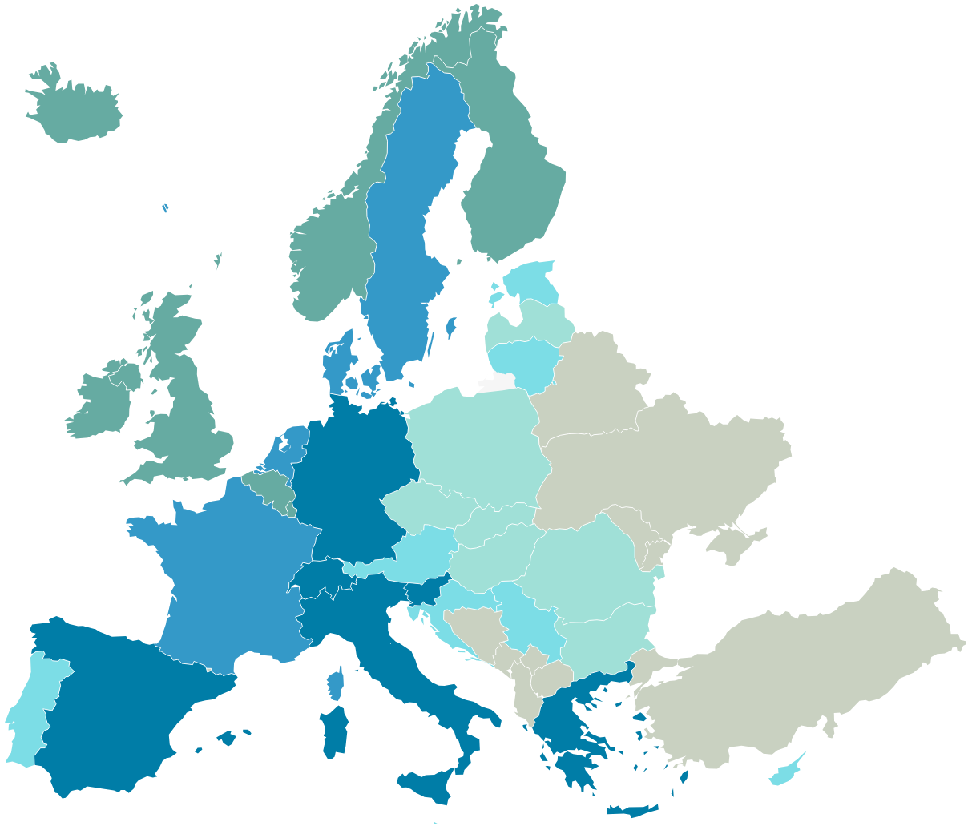






Data and Methods: country clusters
Cluster analysis using TFR and MA1B in 2004 & 2019
Average fertility level and timing
Low and early fertility
“High” fertility and average timing
“High” and late fertility
Very low and very late fertility
High
Average
High & late
Low & early
Very low & very late
7

Slide 8
Data and Methods: calculations by age group
Predicted probability of having a child quickly in a new union
Predicted probability of experiencing a union dissolution quickly after the birth
Predicted probability of childbirth outside a union
t₁
t₂
t₃
t₄
Childless
Benchmark = child vs no child in any
partnership situation
Single
Outcome:
Child vs no child
Partnered
t₁
t₂
t₃
t₄
Childless,
partnered
Benchmark = separation vs no separation
if no birth
Outcome:
Separated vs not separated
Birth
t₁
t₂
t₃
t₄
Childless
Birth
Outcome: outside vs in a union
8

Slide 9
Results. General overview of the three analyses
Predicted probabilities of having a child quickly after union formation (H1A)
Predicted probabilities of ending a relationship quickly after birth (H1B)
Among those with a birth, predicted probability of being single at birth (H1C)
9
Own elaboration based on EU-SILC data. All countries, years 2004-2023.
Notes:
The fact that we do not have duration of union while the risk of separation depends on the duration of the partnership: Is the fact that we do not control for union duration a limitation of the methodological setup? Given that separation risks are higher at shorter union duration (find text), if people were having their children in frailer unions those could also be shorter, so it would also contribute to higher risk of separation. So overall we do not find evidence here that having a child late corresponds to higher breakup risks, I think it is fine.
This reasoning may also help explaining why over time the risk of separation with a child has become larger than without: we do not control for union duration, and this may reflect a shortening of union duration before having a child? Although I haven’t heard that there is an acceleration at any age, and our results for H1A over time do not show that… So possibly, unions are increasingly broken up after a birth, whatever the reason???
In comparison with the general age pattern/profile of having a child in the observation window (benchmark), those who start a relationship at age 35-39 are more likely to have a child.
We are not showing the detail by country cluster for separation as there was no variation from the benchmark at any age in any cluster

Slide 10
Results. Having a child shortly after starting co-residing, by country cluster
Predicted probabilities of having a first child in t₂, t₃, or t₄, among childless women, by age and by changes in union status.
Cluster: High fertility, average timing (Belgium, Finland, Iceland, Ireland, Luxembourg, Norway, UK)
Cluster: High & late fertility (Denmark, France, Netherlands, Sweden)
10
Own elaboration based on EU-SILC data. All countries, years 2004-2023.
Notes:
We show only the clusters that display significant age pattern differences between the benchmark and those who started a relationship at the beginning of the interval.
We observe that in these two clusters with high fertility, the age profile of having a child quickly in a new union is much more shifted towards older ages than the benchmark, which suggests a faster transition to a first birth in later unions.
In all the other country clusters, there was no difference between the age profile of the benchmark and of those who formed a partnership at the beginning of our observation window.
So in fact, it is in countries with high fertility (and where there is large recuperation) that there is a specific acceleration pattern for older women who form a partnership, not necessarily in countries with late fertility (counter-example of the cluster that includes Spain and Italy).

Slide 11
Results. Having a child outside a co-residential union, by country
Predicted probabilities of having a child outside a co-residential union among women who had a child during the observation period.
Cluster: High & late fertility (Denmark, France, Netherlands, Sweden)
Cluster: Very low & very late fertility (Germany, Greece, Italy, Slovenia, Spain, Switzerland)
11
Own elaboration based on EU-SILC data. All countries, years 2004-2023.
Notes:
* Some were suggesting that the countries where there is more postponement are also the countries with more resources given to childrearing, where women can be wealthier and where it is more feasible to bring up a child alone. Don’t know whether this really fits the Southern European countries though.
Link to IVF/ART access in these countries (I said we are doing this in another paper, but obviously we can have a bit of this in the discussion, saying that this is for future research – it will also avoid reviewers to ask us to expand into that direction, would they want for some reason).
Comment with the idea that more women could become accidentally pregnant at older ages because they have stopped using contraception because they think they can no longer have a baby. I answered that in my view if women have been able to use contraception effectively until that age then they are still able to use it effectively at that age. So in some way even if it is the case that there are more unintended pregnancies, this would be part of the continuum of “accepting to become pregnant” at that age. And the fact that in a full range of countries where late fertility is not developed there are not more late solo-births also seems to indicate that when necessary, women know very well how not to have a child alone at later ages. We can have some elements on this in the discussion, it is interesting.
Question on income: women need higher income to be able to have a child alone, so in countries where more women have higher income it may be that this drives the capacity to have (and then having) children alone at higher ages. Let’s discuss something on income and individual situations, also linked to the country child-friendliness I guess? We could also discuss level of education, health, etc. and open for further research. But since we are at the aggregate level otherwise, I wouldn’t start controlling for stuff for this paper, what do you think?
Again, we show the clusters that display significant age patterns, and this time those are both late fertility clusters. In both, women who have children later more often have it outside a relationship, and it is even more the case in the high fertility cluster.

Slide 12
Review of results
We observe that older women are more likely to have a first child shortly after entering a co-residential union, particularly those aged 35–39 (H1A).
  This effect is driven by high-fertility countries, but does not necessarily appear in late-fertility countries (H2).
We find no evidence that older women are more likely to experience union dissolution after the birth of a child (H1B).
The likelihood of having a child without a co-resident partner increases steadily with age and is especially high among women aged 40–45 (H1C).
  This effect is more evident in countries characterized by later fertility patterns (H2).
    We identified a potential adaptation process that involves relaxing the prerequisites for having children at older reproductive ages.
12

Slide 13


Thank you!
Cristina Suero
cristina.suero.garcia@univie.ac.at
Eva Beaujouan
eva.beaujouan@univie.ac.at
Acknowledgements.
BIC.LATE receives funding from the European Research Council (ERC) under the European Union’s Horizon 2020 research and innovation programme (grant Agreement No 101001410).
wittgensteincentre.org
dataexplorer.wittgensteincentre.org

Slide 14
Data and Methods: indicators
Among childless single women at t₁ who enter a co-residential union in t₂ or t₃, we estimate the likelihood of having a first child in t₂, t₃, or t₄, by age group. We compare it to the likelihood of having a child among all other childless women (our benchmark).
Among childless women who had a child within a co-residential union in t₁, t₂, or t₃, we estimate the likelihood of experiencing a union dissolution in t₂, t₃, or t₄, by age group. We compare it to the likelihood of separation among childless women who did not have a child over the observation period (our benchmark).
Among women childless before t1 who had a child during the observation period, we assess the likelihood that this child was born while the woman did not have a co-resident partner, by age.
14

Slide 15
Appendix 1. Clusters
Cluster analysis using fertility characteristics
MA1B2004, MA1B2019-2004 (year increases)
TFR2004, TFR2019-2004 (year increases)
Own elaboration based on EU-SILC data. Years 2004-2023.
15

Slide 16
Appendix 2. Full results
H1A. All time periods
Own elaboration based on EU-SILC data. Years 2004-2023.
16

Slide 17
Appendix 2. Full results
H1A. All clusters
Own elaboration based on EU-SILC data. Years 2004-2023.
17

Slide 18
Appendix 2. Full results
H1B. All time periods
Own elaboration based on EU-SILC data. Years 2004-2023.
18

Slide 19
Appendix 2. Full results
H1B. All clusters
Own elaboration based on EU-SILC data. Years 2004-2023.
19

Slide 20
Appendix 2. Full results
H1C. All time periods
Own elaboration based on EU-SILC data. Years 2004-2023.
20

Slide 21
Appendix 2. Full results
H1C. All clusters
Own elaboration based on EU-SILC data. Years 2004-2023.
21

Slide 22
4. Results. Stop co-residing with a partner shortly after child, by country
Predicted probabilities of experiencing a union dissolution in t₂, t₃, or t₄, by age group and by changes in parity.
Cluster: Average fertility level and timing (Austria, Croatia, Cyprus, Estonia, Lithuania, Malta, Portugal, Serbia)
Cluster: Very low and early fertility (Bulgaria, Czechia, Hungary, Latvia, Poland, Romania, Slovakia)
22
Own elaboration based on EU-SILC data. All countries, years 2004-2023.

