Slide 1

Infertility and the Shortfall between Ideal and Actual Family Size
Ester Lazzari, Wittgenstein Centre & University of Vienna Eva Beaujouan, Wittgenstein Centre & University of Vienna
International Population Conference
Brisbane, July 14th, 2025

Slide 2
Late Fertility and Unfulfilled Fertility Ideals
How to explain the gap between ideal and actual family size?
Social and economic barriers (e.g., economic difficulties, high-cost of raising children, incompatibility between family and career)
Less attention given to difficulty conceiving (implicit assumption that couples can have children if they want)
Late fertility has shifted the life-course context where childbearing takes place
Increasing risk of infertility with age
17.5% (lifetime infertility prevalence) (Cox et al. 2022)
Increasing use of MAR - especially among older women (Smeenk et al. 2024) – however treatments are often unsuccessful

Slide 3
Aim of this Study
Describe the discrepancy between fertility ideals and outcomes
Do individuals meet, exceed, or fall short of their fertility ideals by the end of their reproductive life?
Measured retrospectively
Explore the role of infertility experiences in influencing this discrepancy - along with other factors reflecting life course events and structural constraints which may influence people’s ability to realise their childbearing aspirations

Slide 4
Measuring the Discrepancy between Fertility Preferences and Outcomes (1)
Studies measuring the discrepancy usually use a longitudinal approach comparing early-life fertility intentions to outcomes later in life:
Short-term perspective — 3 to 4 years (Speder & Kapitany 2009; Regnier-Loilier & Vignoli 2011)
Long-term perspective — (Almost) the entire reproductive window (e.g. Beaujouan & Berghammer 2019)
Challenges of measuring fertility intentions in young adulthood
Uncertainty at the time of measurement — Fertility preferences are flexible (Trinitapoli and Yeatman 2018)
Intentions may change—as a result of actual change in preferences or the emergence of constraints (Rackin and Bachrach 2014)
Assess fertility ideals and outcomes at the end (Casterline & Han 2017; Channon & Harper 2019; de Carvalho et al. 2016) — the approach used in this study
Meaningful as it indicates that an important life goal has remained unfulfilled and not due to changing preferences

Slide 5
Data Sources – RQ1
Generations and Gender Survey II (second round)
Cross-sectional nationally representative survey conducted in 2020-23 across many countries in Europe and Latina America (data are available for 13 countries so far)
Sample
4,589 men and 6,465 women aged 42-50
Across 10 countries
Variables
Outcome: Actual family size at age 42-50 (including both biological and adopted children)
Preference: Ideal family size at age 42-50: ‘For you personally, what would be the ideal number of children you would like to have or would have liked to have?’

Slide 6
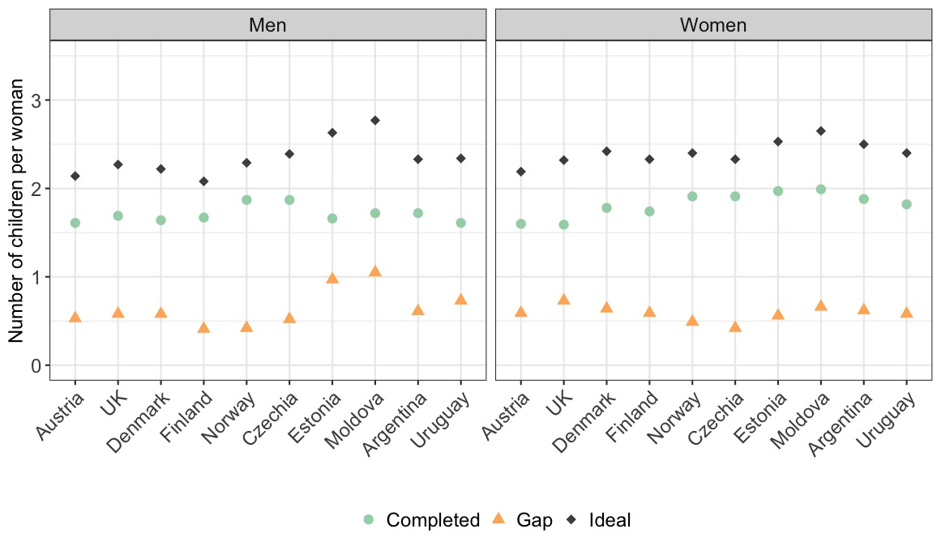
Ideal and Actual Family Size – Aggregate Level
F1.
Notes. Men and women aged 42-50. Data sources. GGS II

Slide 7
Ideal and Actual Family Size – Individual Level
Ideal Family Size > Actual Family Size
Between one-third and half of women
Between one-fourth and one-third of men
Ideal Family Size < Actual Family Size
2-4% of women
2-6% of men

Slide 8
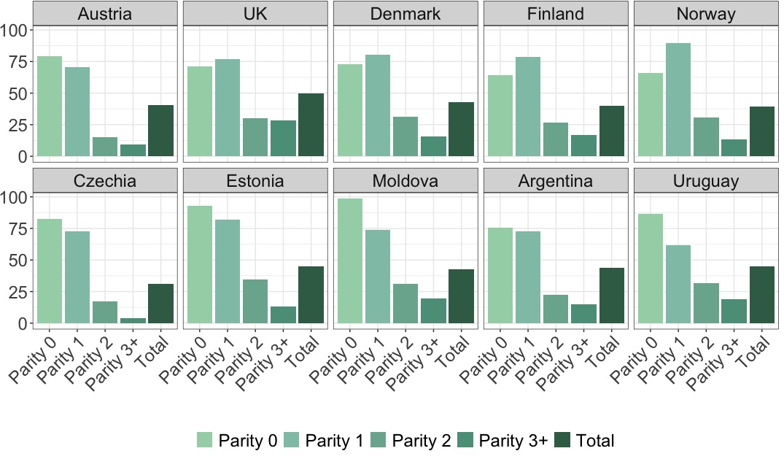
Ideal and Actual Family Size by Parity - Women
F2. Share of women with a completed family size smaller than ideal.
Notes. Women aged 42-50. Data sources. GGS II

Slide 9
Data sources and Methods – RQ2
Generations and Gender Survey II (second round)
Experience with infertility: ‘Was there ever a time when you and your partner were trying to get pregnant but did not conceive within at least 12 months?’
Union trajectories: Currently in their 1st union, separated, re-partnered, never in a union.
Age at first union
Fertility postponement: Whether the respondent was still childless at age 30
Educational attainment: Tertiary or below
Sample
4,213 men and 5,831 women aged 42-50 across 10 countries
Analysis
Logistic regression models predicting underachievement of ideal family size

Slide 10
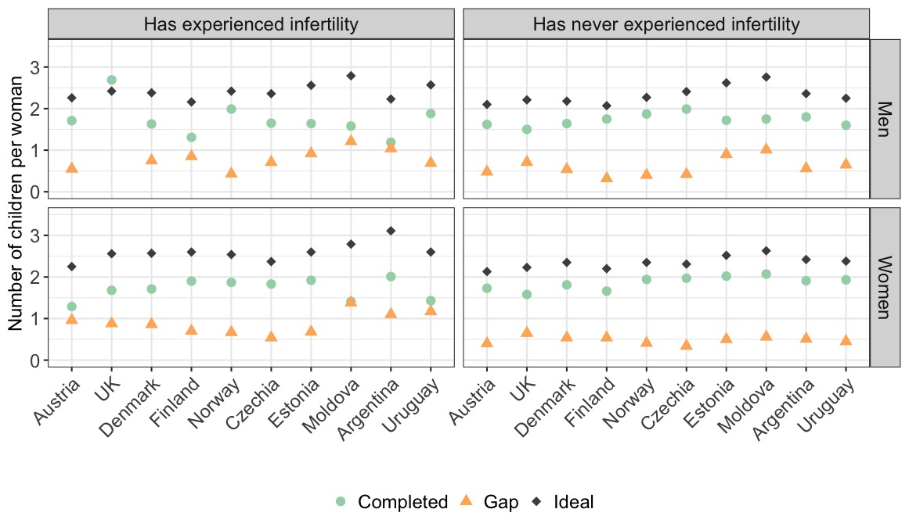
Ideal and Actual Family Size by Infertility Experience
F4.
Notes. Men and women aged 42-50. Data sources. GGS II

Slide 11
Logistic Regression Analyses
 | UK, women
 | M1 |  | M2
Relationship history (Ref.: In first union) | OR | p- value | OR | p-value
Separated | 5.08 | *** | 5.27 | ***
Repartnered | 1.60 |  | 1.65 | *
In 3+ union | 2.37 | ** | 2.38 | *
Never been in a union | 4.45 | *** | 4.98 | ***
Age at first union (Ref.: 25 or less)
26-30 | 1.33 |  | 1.30
31-35 | 2.11 |  | 2.25
35 or above | 1.60 |  | 1.71
Fertility postponement (Ref.: Parent by age 30)
Not a parent by age 30 | 1.63 | * | 1.50 | ***
Education (Ref.: Non-tertiary)
Tertiary | 0.76 |  | 0.75
Ever experienced infertility (Ref.: No)
Yes |  |  | 1.92 | **
Constant | 8 | *** | 1 | ***
N | 408 |  | 408
T1. Odds ratios from logistic regression predicting unrealized fertility.
Notes. Men and women aged 42-50. Data sources. GGS II

Slide 12
Limitations
Justification bias
Retrospective reports and recall bias
Fertility reports mostly consistent with population-based estimates (Leocádio et al., 2023)
Possible underreporting of infertility experiences
Although only 2.6% refused to answer

Slide 13
Conclusion
People experiencing infertility are more likely to fall short of their fertility ideals
In the context of late fertility, narrowing the gap between ideal and actual family size requires closer attention to the role played by infertility and its treatment.
Family support policies (e.g. childcare, parental leave) are essential but do not assist those struggling to conceive
Raising awareness about the impact of age on fertility may serve as a preventive strategy against unmet childbearing goals

