Slide 1
Social Norms towards ART in Italy:
A Vignette Study
Daniele Vignoli¹ – Ester Lazzari² – Valentina Tocchioni¹ – Marco Cozzani¹
¹ University of Florence
² University of Vienna

Slide 2
ART in Italy
The use of ART remains relatively uncommon compared to the potential demand
Nonetheless, there has been a 73% increase in ART-related deliveries, escalating from 8,000 in 2012 to surpass 14,000 in 2022 (Italian Ministry of Health)
In 2022 ART now constitutes 3.7% of all deliveries; it was 1.8% in 2012
The proportion of deliveries involving ART reaches 18.1% for women over 40; it was 6.9% in 2012

Slide 3
Aim of the paper
This paper aims to assess the role of social norms towards ART in Italy through the use of a Factorial Survey Experiment (FSE)
Objectives:
to establish the causal impact of different possible characteristics of the ART treatment on what a couple should and will do with respect to the eventual use of ART to achieve their fertility goals
to analyse heterogeneity based on couples’ characteristics

Slide 4
Methodology
Data collection between July 4th, 2024 and October 15th, 2024
Sample size: 4,728
Target sample: individuals in a heterosexual union (married, cohabiting, or LAT)
Age range: 25-49
Quotas: sex, 5-year age classes, region of residence, education (by sex)

Slide 5
The vignettes
We manipulate several dimensions:
Three dimensions relate to the couple’s situation:
woman’s age group,
if the couple already has one child (and related income)
time spent in attempting conception
Three dimensions relate to the ART treatment:
cost of treatment
source of gametes
proximity to the fertility center

Slide 6
The vignettes
Dimensions (and levels):
Parity (2): childless vs. one child (with a household income related to the parity)
Woman’s age group (4): <35 years old; 35-39 years old; 40-42 years old; >=43 years old
Time spent in attempting conception (3): 1 year; 2 years; 3 or more years
Cost of treatment (2): 3,000 euros vs. no living costs
Source of gametes (3): Homologous; heterologous (sperm from donor); heterologous (egg from donor)
Proximity to the infertility center (3): Within the resident region / Outside the region / Abroad
Number of vignettes: 2² x 3³ x 4 = 432

Slide 7
Caterina and Tommaso are a childless couple who have been trying to conceive for a year and are considering assisted reproductive techniques because they have not yet succeeded with natural conception. The couple’s net annual income is 35,000 euros. Since Caterina is under 35, the total cost of the assisted reproduction procedure they would undergo is 3,000 euros, and the type of treatment recommended by their doctor is homologous fertilization. Finally, the infertility center they are considering is located in the couple’s region of residence.
In your opinion, should Caterina and Tommaso use ART?
Lastly, what should Caterina and Tommaso do?
• Initiate ART treatment without delay;
• Persist in natural conception attempts for an additional year before considering ART;
• Persist in natural conception attempts for two years before considering ART;
• Continue trying to conceive naturally without a specific time frame;
• Consider the possibility of adopting a child;
• Abandon their plan of having a child
0 | 1 | 2 | 3 | 4 | 5 |  | 6 | 7 | 8 | 9 | 10
Very unlikely |  |  |  |  |  | Very likely

Slide 8
The vignettes
Levels of dimensions are randomly assigned to vignettes, and vignettes are randomly assigned to respondents
To have enough observations per vignette, each respondent answers 6 vignettes
With 4,728 cases*6 vignettes we have ~66 observations for each of the 432 possible vignettes

Slide 9
Methods – within approach
Combined analysis of multiple vignettes per respondent: within approach
We tested random-effect and fixed-effect OLS regressions to deal with the nested data structure
Identical results: we opted for the most efficient (random-effect)

Slide 10
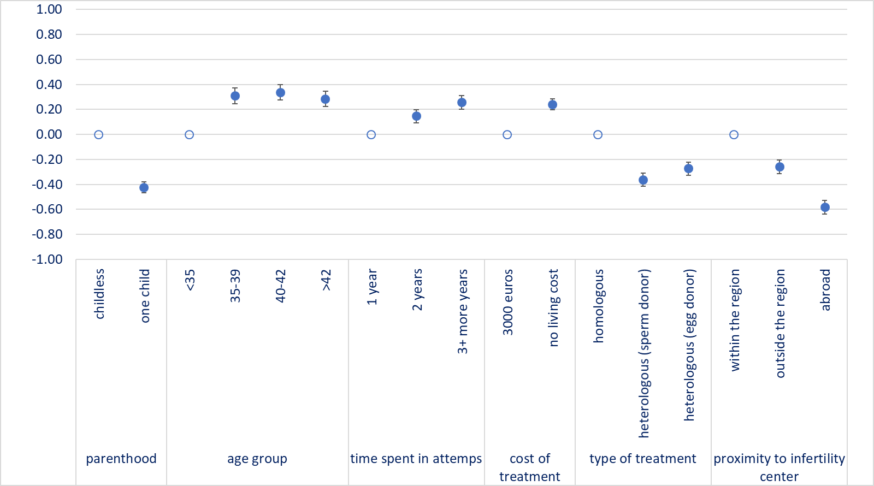
Results
Figure – Beta coefficients (with 95% confidence intervals) from random effect regression models on the likelihood that the fictitious couple will use ART treatment by dimensions of vignettes

Slide 11
Results
Table –Respondents’ recommendations to the fictitious couple between the best-case scenario of ART treatment and the worst-case scenario of ART treatment, by parity of the fictitious couple (percentage frequencies)
What should Caterina and Tommaso do? | fictitious couple without children |  | fictitious couple with a child
 | BCS | WCS | BCS | WCS
Initiate ART treatment without delay | 30.7 | 33.9 | 25.4 | 18.5
Persist in natural conception attempts for an additional year before considering ART | 25.8 | 15.4 | 20.9 | 23.1
Persist in natural conception attempts for two years before considering ART | 21.0 | 4.6 | 29.9 | 9.2
Continue trying to conceive naturally without a specific time frame | 16.1 | 9.2 | 11.9 | 13.9
Consider the possibility of adopting a child | 4.8 | 32.3 | 10.5 | 26.2
Abandon their plan of having a child | 1.6 | 4.6 | 1.5 | 9.2
Total | 100.0 | 100.0 | 100.0 | 100.0
Best-case scenario (BCS):
Woman younger than 35
One year spent in attempting conceiving
No living cost for a homologous treatment within the region of residence
Worst-case scenario (WCS):
Woman older than 42
Three years or more spent in attempting conceiving
3,000 euros for a heterologous treatment (sperm donor) abroad
Notes:
Note: background is coloured in light grey for differences smaller than 1.30; in grey for differences between 1.30 and 1.69; and in dark grey for differences equal to or larger than 1.70.

Slide 12
Conclusions
Personal characteristics of couples—such as the woman’s age, parity, and time spent trying to conceive—are the most significant factors influencing attitudes toward ART
While the cost of ART also holds importance, proximity to fertility centers tends to be perceived as less relevant
The type of ART plays a critical role: methods that replicate traditional family structures by enabling infertile heterosexual couples to have biologically related children (homologous) are generally viewed more favorably

Slide 13
Conclusions
When (childless) couples face infertility problems, their attitudes toward ART tend to be quite positive, even when these methods challenge traditional family models
This is notable even in a country like Italy, which is often characterized as "traditional"

Slide 14
Thank you!

