Slide 1
The gap between ideal and actual family size: the Role of Infertility
Ester Lazzari¹ & Eva Beaujouan¹
¹University of Vienna & Wittgenstein Centre for Demography and Global Human Capital
Wittgenstein Centre Conference 2024
Vienna, 21-22 November 2024

Slide 2
The gap between ideal and actual fertility
Many studies examine the gap between desired/intended and achieved family size (e.g., Beaujouan & Berghammer 2019; Berrington & Pattaro 2014; Morgan & Rackin 2010; Nitsche & Hayford 2020; Spéder & Kapitány 2009; )
Usually measured using a longitudinal approach :
Short-term perspective
Long-term perspective
Is this due to people’s changing their preferences?
Results are consistent in that
underachieving is much more common than overachieving
=>

Slide 3
Measuring the gap
Fertility preferences are dynamic:
In early adulthood, they often reflect idealized views and are not “real” plans (Rackin and Bachrach 2014)
They adjust downwards with age
=> The “gap” may be overestimated
An alternative approach is to adopt an end-of life-perspective :
To measure ideals at the end of people’s reproductive lives (Casterline and Han 2017; de Carvalho et al. 2016) . This involves a personal reflection on one’s entire childbearing journey.

Slide 4
Infertility as a predictor of the gap
How to explain the gap:
Relationship trajectories (Berrington and Pattaro 2014; Morgan and Racking 2010)
Financial constraints (Adsera 2006)
Postponement (“age effect”)
Social age limits (Billari et al. 2011; Lazzari et al. 2024)
Biological constraints (infertility)
=>
Clear barrier to the achievement of an ideal family size which has
likely increased in importance due to childbearing delay

Slide 5
Research objectives
Describe the discrepancy between fertility ideals and outcomes
Do individuals meet, exceed, or fall short of their ideals?
Explore factors influencing the discrepancy between fertility ideals and outcomes
What is the relationship between infertility and underachievement?
Men and women
8 European countries

Slide 6
Data
Generations and Gender Survey (GGS) II (8 countries so far)
Ideal family size: ‘For you personally, what would be the ideal number of children you would like to have or would have liked to have?’ compared with number of children ever born
Lifetime infertility: ‘Was there ever a time when you and a partner were trying to get pregnant but did not conceive within at least 12 months’
Sample: ~ 6,100 women & ~ 4,600 men aged 42-50
Explanatory variables for the multivariate analysis: union trajectory, age at first union formation, childless at age 30, education

Slide 7
Research objectives
Describe the discrepancy between fertility ideals and outcomes
- Do individuals meet, exceed, or fall short of their ideals?
Explore factors influencing the discrepancy between fertility ideals and outcomes
- What is the relationship between infertility and underachievement?

Slide 8
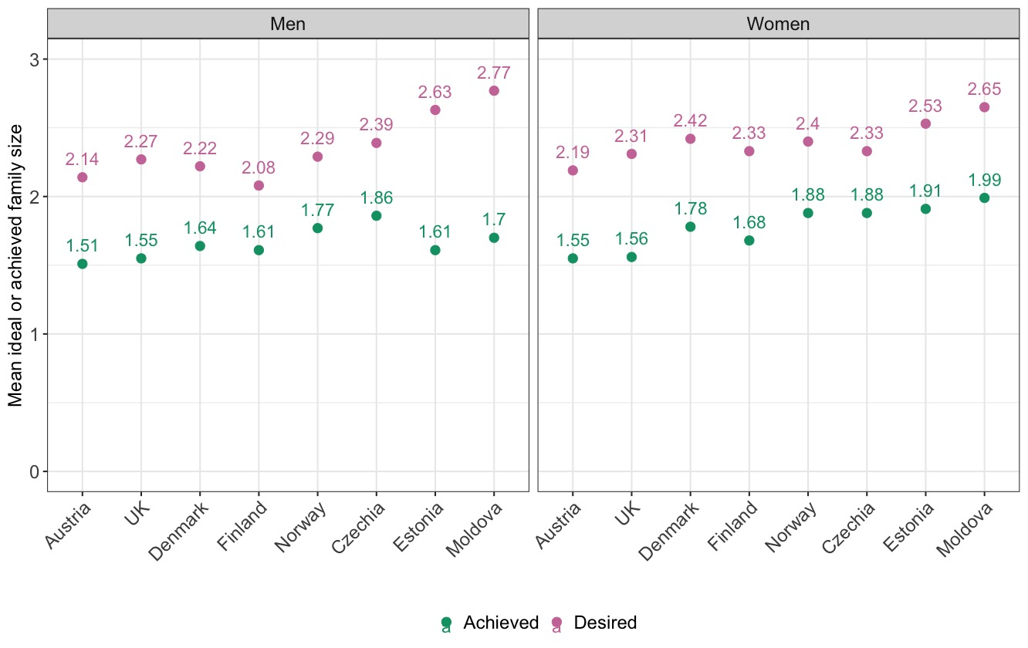
Ideal vs actual family size by age 42-50
F1. Mean ideal and mean achieved family size by age 42-50. Source: GGP II.

Slide 9
Many respondents have fewer children than ideal
%
F2. Percent of respondents who have achieved or underachieved fertility ideals by age 42-50. Source: GGP II.

Slide 10
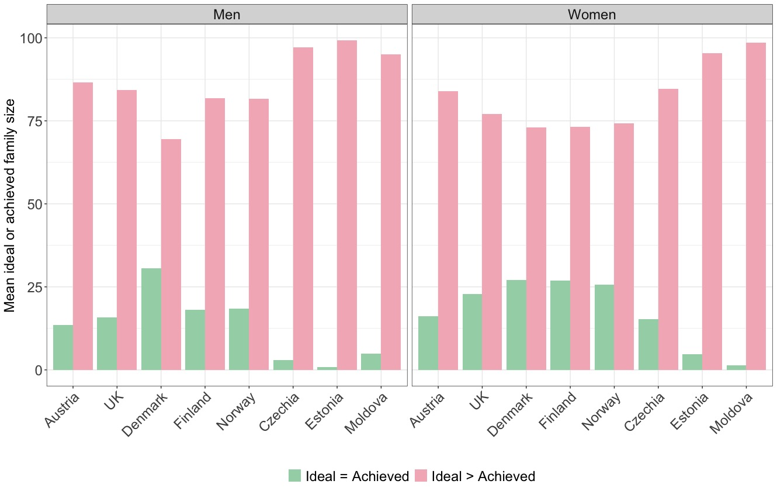
Childlessness is mostly involuntarily
F3. Percent of respondents who have underachieved, achieved, and overachieved fertility ideals by age 42-50, childless respondents. Source: GGP II.
%

Slide 11
Many parents with two children would have liked to have more children
F4. Percent of respondents who have underachieved, achieved, and overachieved fertility ideals by age 42-50, respondents with two children. Source: GGP II.
%

Slide 12
Research objectives
Describe the discrepancy between fertility ideals and outcomes
- Do individuals meet, exceed, or fall short of their ideals?
Explore factors influencing the discrepancy between fertility ideals and outcomes
- What is the relationship between infertility and underachievement?

Slide 13
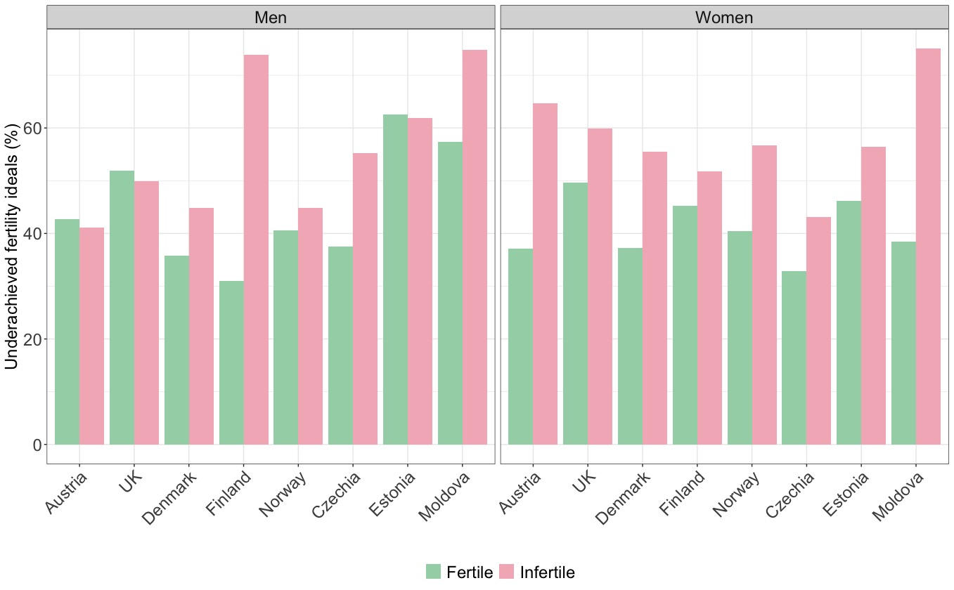
Infertility and underachievement
F5. Percent of respondents who have underachieved fertility ideals by age 42-50, by whether they have experienced infertility in their lives. Source: GGP II.

Slide 14
Predictors of underachievement
 | Model 1 | p-value | Model 2 | p-value
Education
Non-tertiary (Ref.)
Tertiary | 0.93 |  | 1
Relationship status
In first union (Ref.)
Separated | 2.38 | ** | 2.54 | **
Repartnered | 1.61 | * | 1.8 | **
In 3+ union | 2.53 | *** | 2.67 | ***
Never been in a union | 1.8 | * | 3.19 | *
Age at first union
25 or less (Ref.)
26-30 | 1.02 |  | 1.09
31-35 | 1.15 |  | 1.01
Above 35 | 1.58 | ** | 1.49 | *
Fertility postponement
Parent by age 30 (Ref.)
Not a parent by age 30 | 3.22 | *** | 2.65 | ***
Lifetime infertility
No (Ref.)
Yes |  |  | 3.51 | ***
N | 788 |  | 788
T1. Binary logistic regression predicting underachievement vs achievement or exceeding the ideal family size for women, Austria.
Notes: †p < .10; *p < .05; **p < .01; ***p < .001
Source: GGPII

Slide 15
Final remarks
Gap between ideal and actual fertility
Consistent with previous research comparing early preferences and actual fertility
Stronger support that the gap is not due to changing ideals but to actual constraints
Maybe underestimated (justification bias)
Postponement is a key determinant of the gap (both its social and biological component)

