Slide 1
Too old to be sure: Swinging fertility timing intentions of childless men and women over the life course
Shalini Singh
(Department of Demography)
University of Vienna
Wittgenstein Centre Conference 2024– 21st November 2024

Slide 2
Context
Fertility Intentions (wantedness, no. of children, certainty, timing ).
Existing literature focused on “family size”, “short-term intention”, “degree of certainty in intentions”
Fertility Timing – The age at which individuals or couples have children.
Fertility Timing Intention – The age at which individuals or couples want to have children.
Research Question – “How do Childless people shift their intended age to enter parenthood in relation to their age and partnership status?”
Why age and partnership status??
The certainty of reproductive intentions may vary based on age and partnership status (Ní Bhrolcháin and Beaujouan, 2011).

Slide 3
Data Source & Sample
Data – PAIRFAM (Panel Analysis of Intimate Relationships and Family Dynamics).
German yearly panel data (waves 1-14)
Four birth cohorts: 1971-73, 1981-83, 1991-93 and 2001-03.
Which implies that Not everybody is at the same age at each point of time (in each wave).
Main Variable of interest : “Intended realistic age to have first child”.
Survey Question (frt9) : When you think realistically about having children : How old do you think you will be when you have your first child?
Age ___
I haven’t thought about that
No answer
Sample Selection : Childless men and women from birth cohorts (1991-1993) and (1981-1983) who were asked the question on fertility timing intention

Slide 4
Response on Intended realistic age to have first child by current age of respondent.
(n= 8034 individuals and N= 37808 observations)

Slide 5
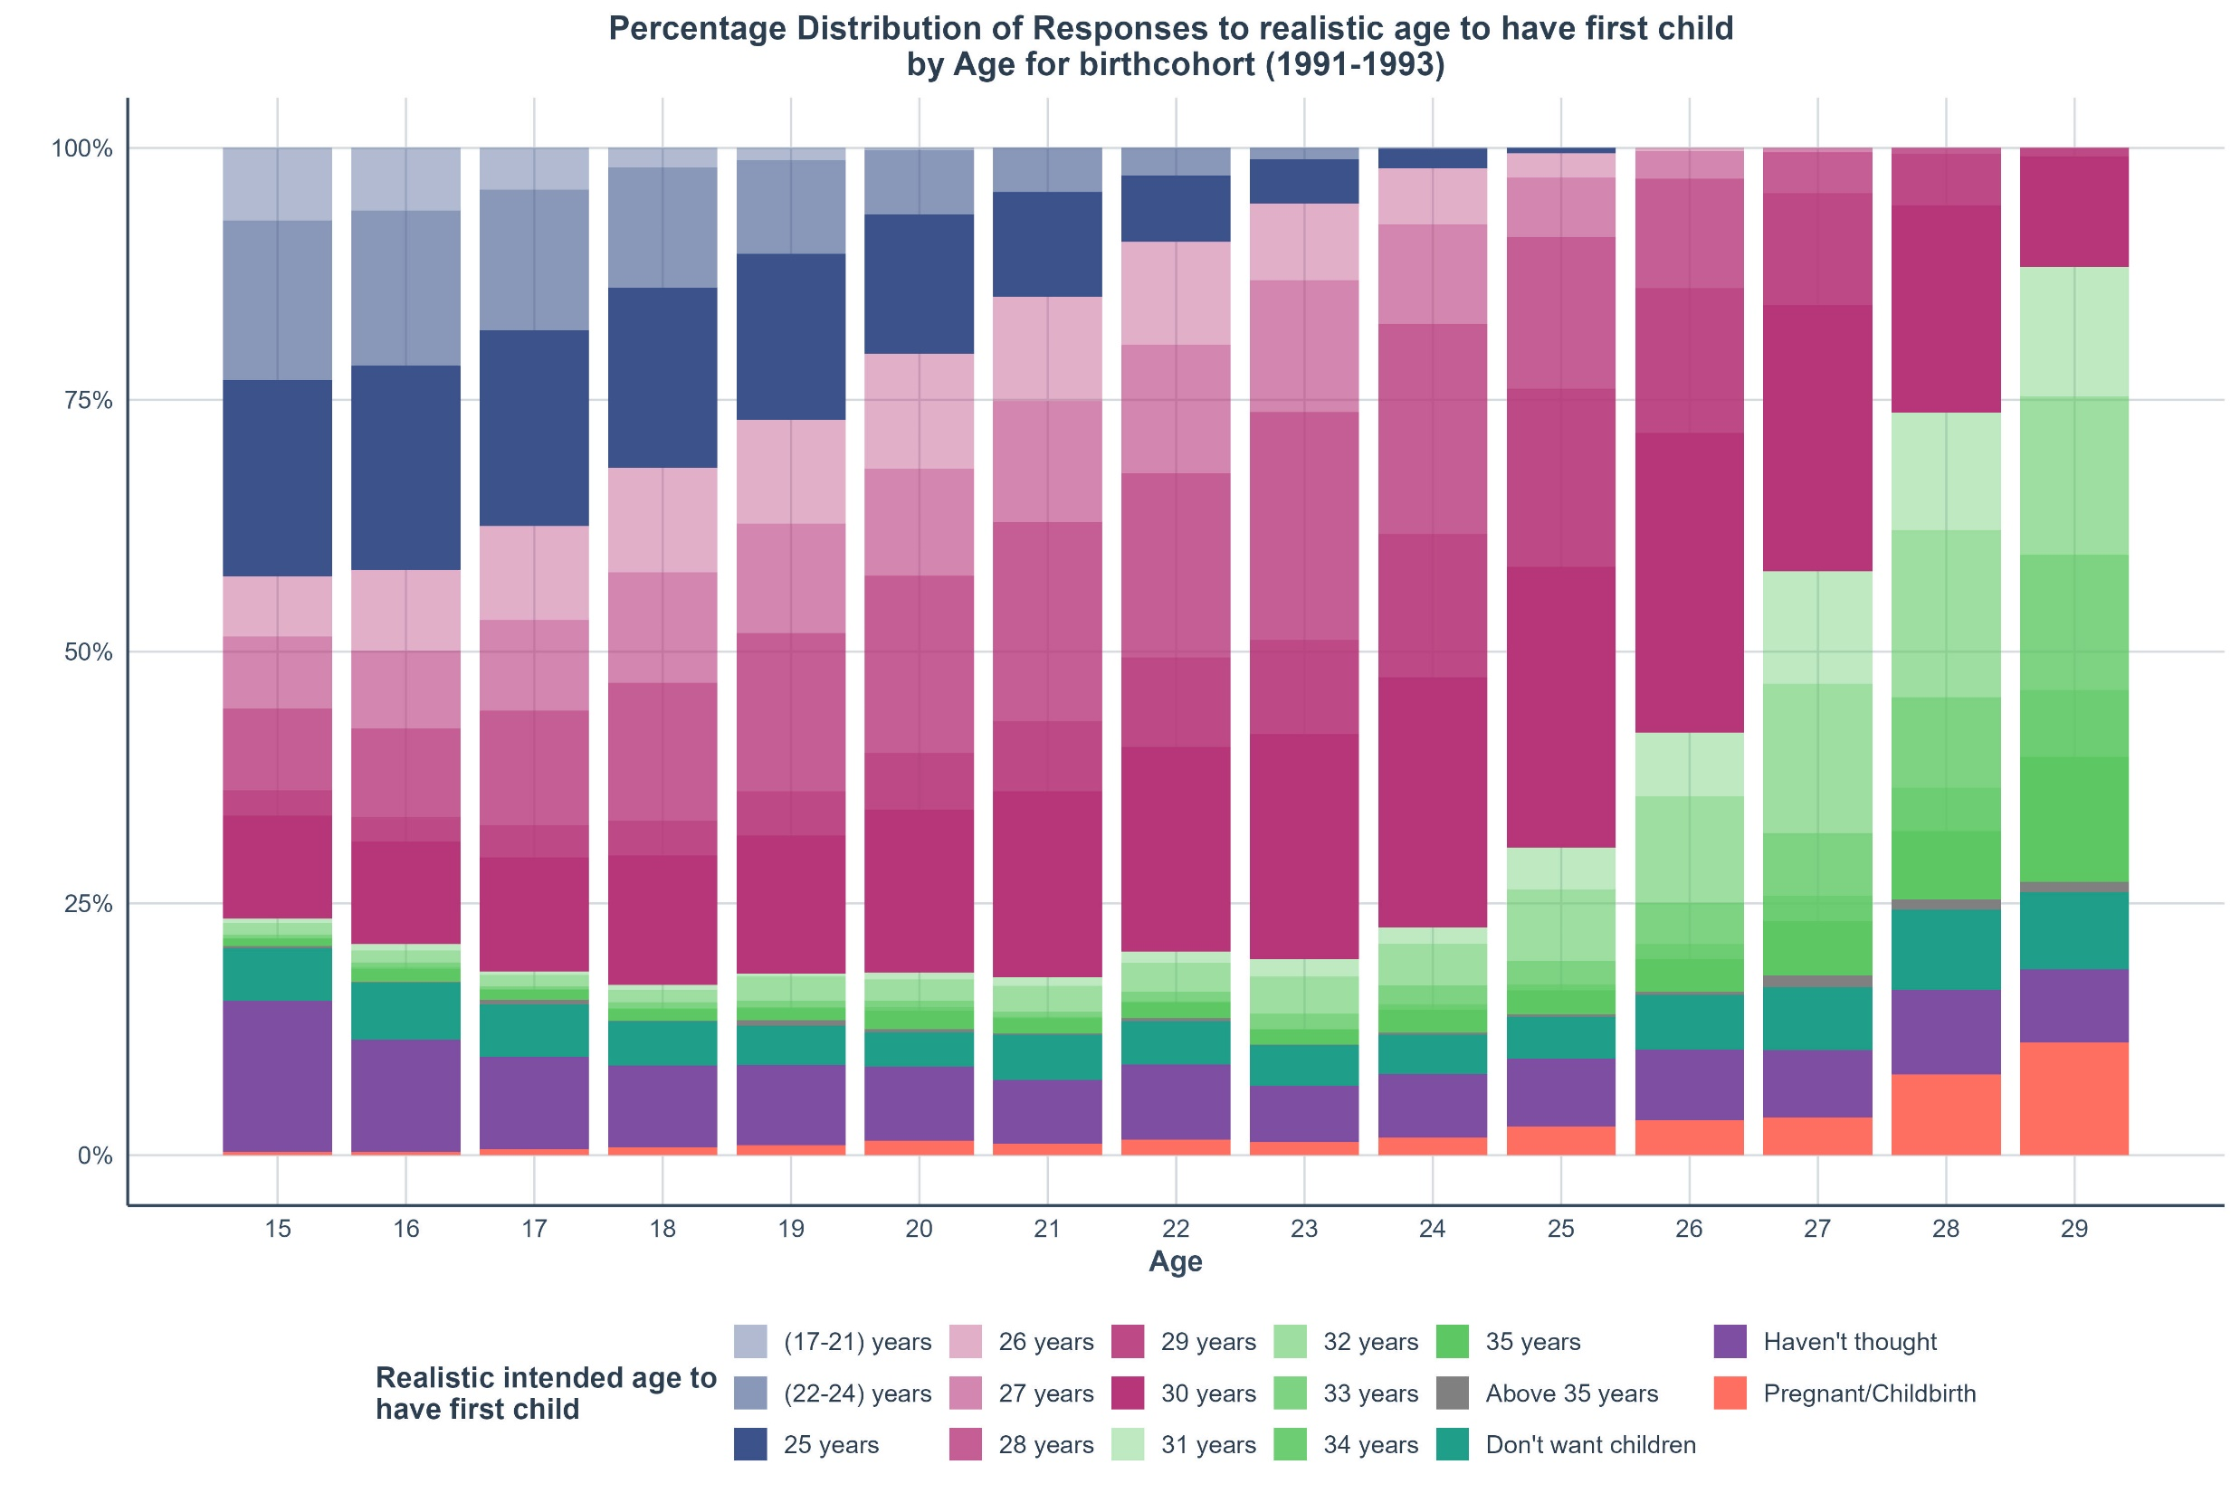
Notes:
4017 unique individuals contributing 25386 person-years

Slide 6
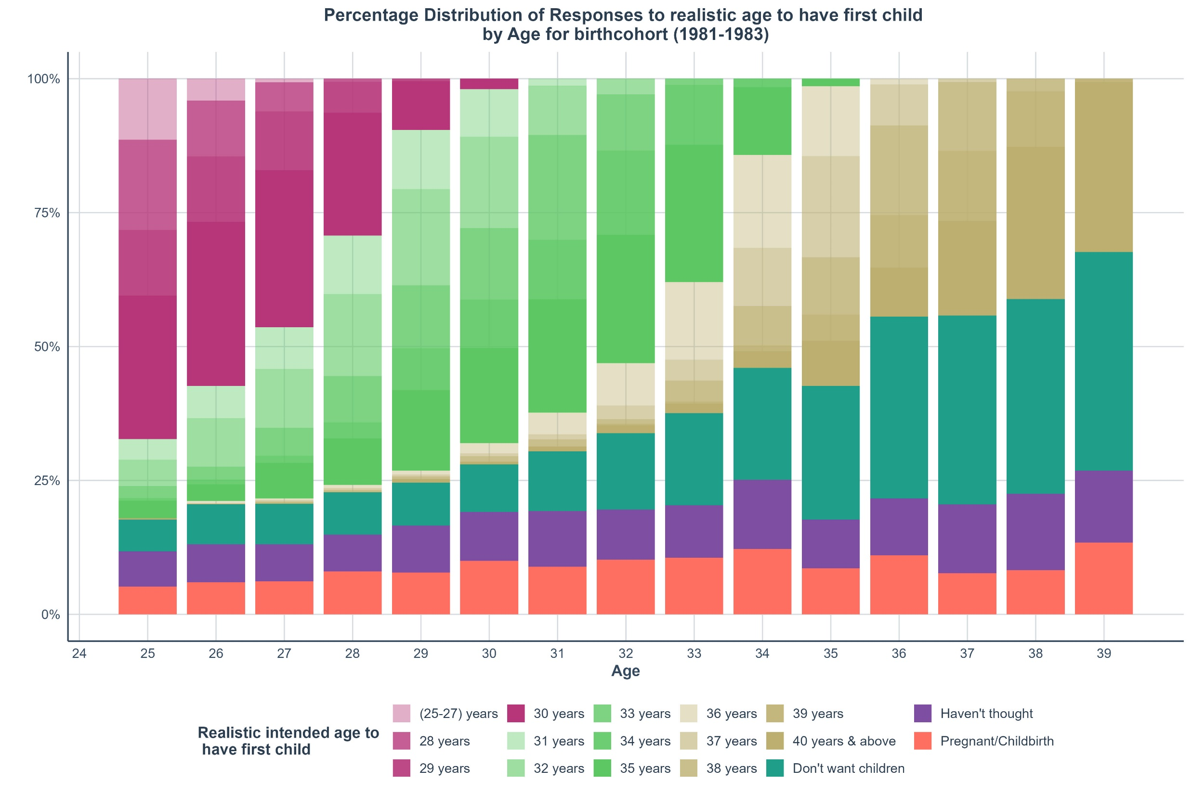
Notes:
1989 unique individuals contributing 10481 person-years

Slide 7
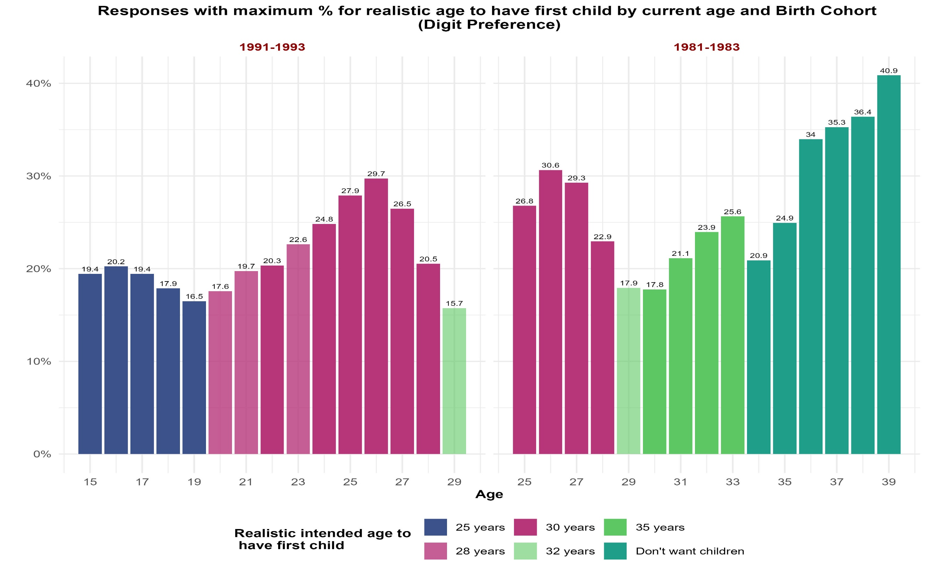

Slide 8
Changes in Response on Intended realistic age to have first child by transition/no transition in partnership status (accounting for age groups).
For birth cohort (1991-1993), Transition/no transition in partnership status does not have a significant effect on intended childbearing age.
For older birth cohort (1981-1983), partnership status matters particularly at higher age groups.
A significant proportion of people shift their intended childbearing age downwards when transitioned from being single to partnered and upwards when transitioned from being partnered to single.
A large proportion of individuals are unsure of fertility timing or don’t want children at late ages if they remained single in consecutive years.

Slide 9
I. Research Question
Thank-you!
Thank-you!

Slide 10
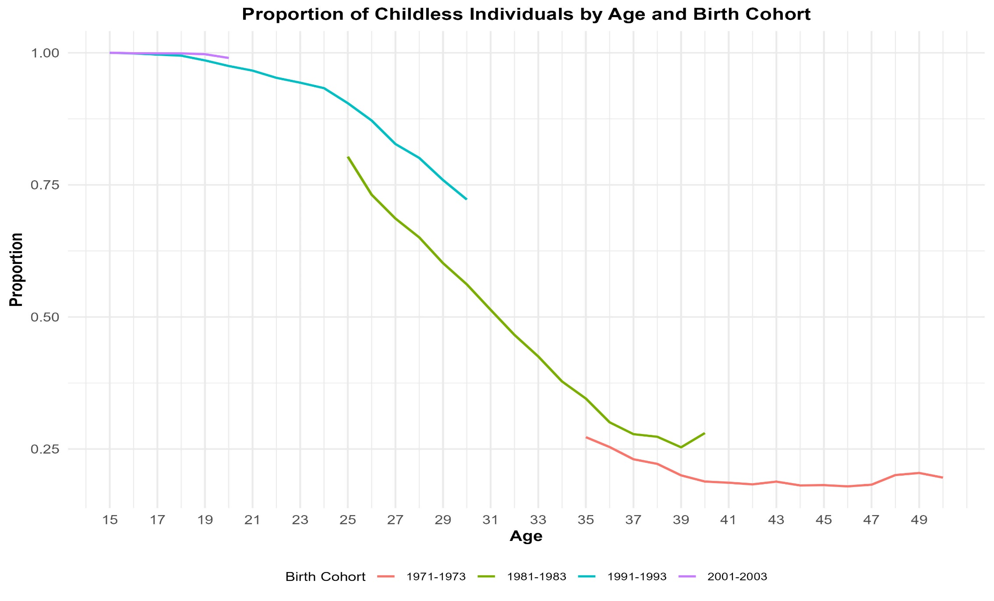
Source : Pairfam (waves: 1 to 14)

Slide 11
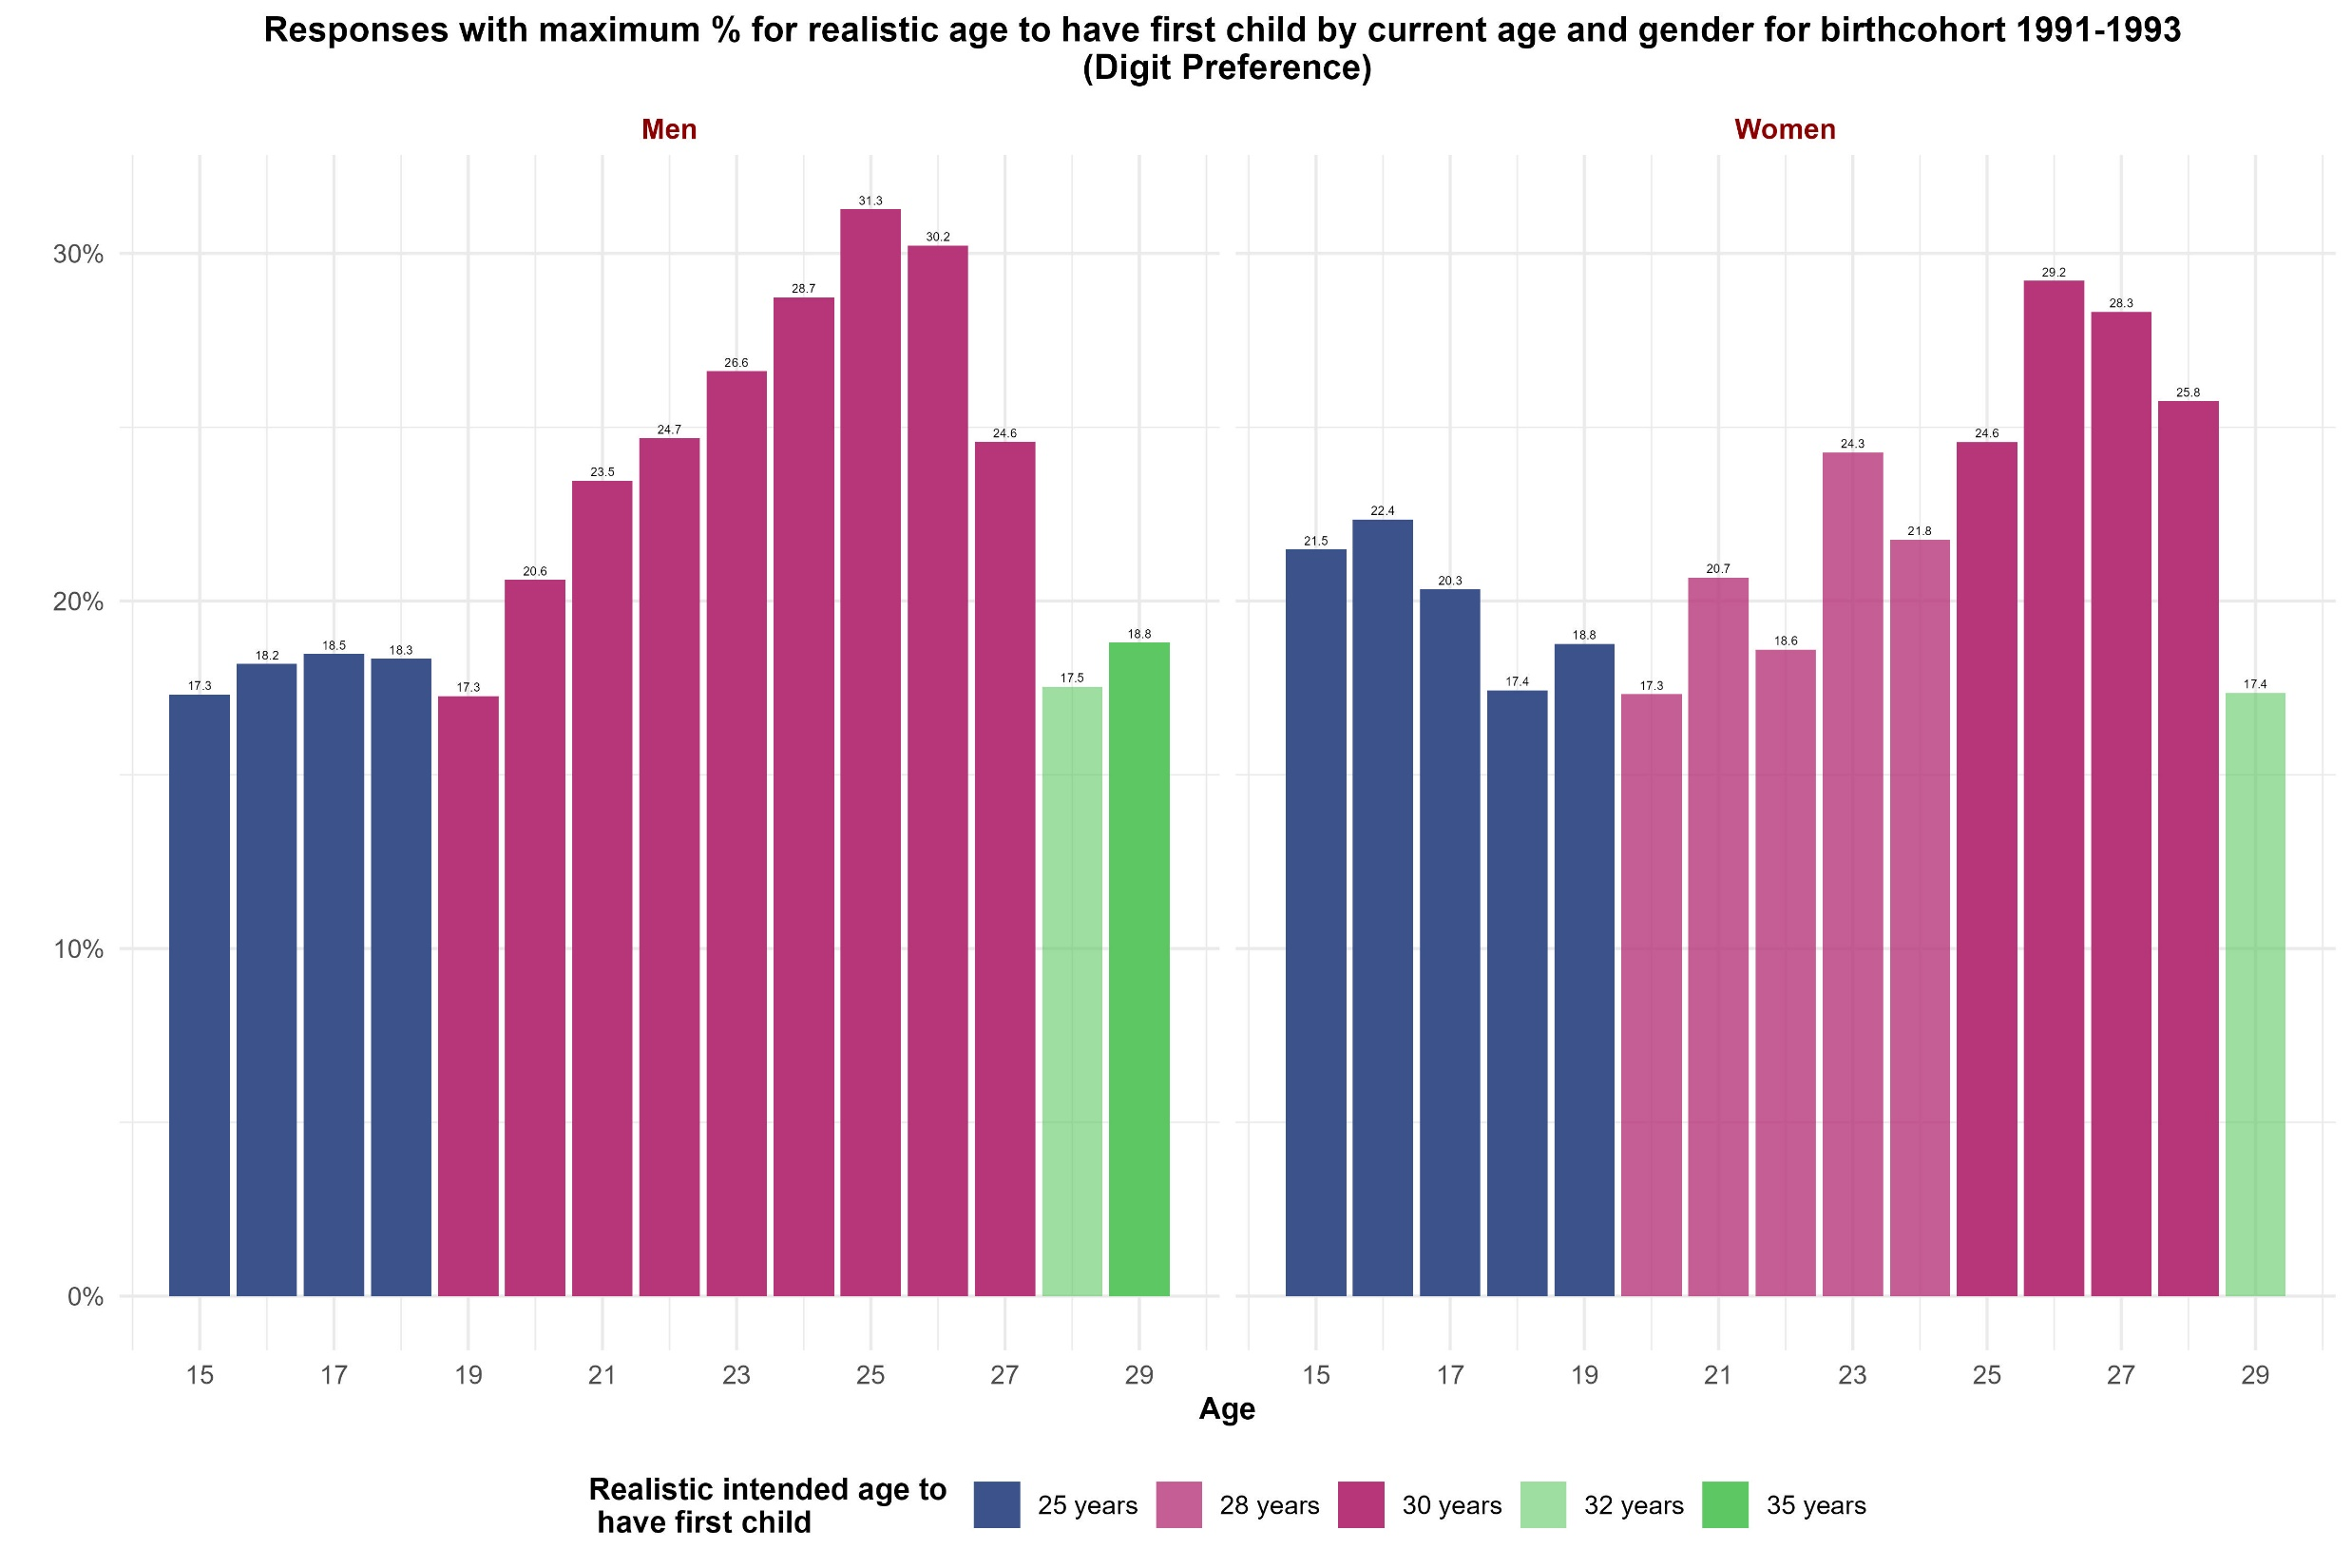

Slide 12
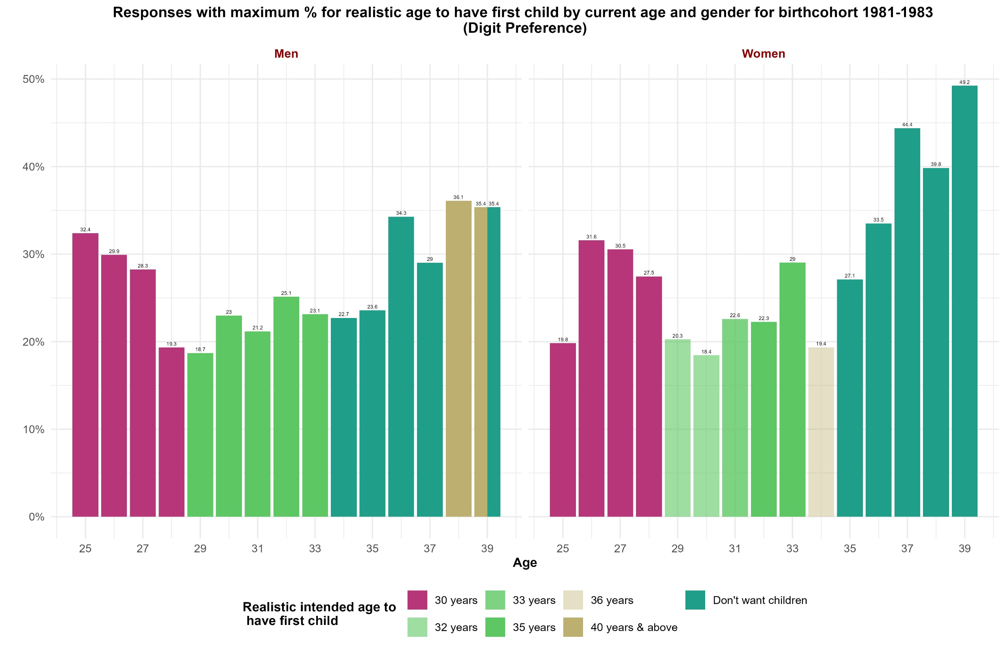

Slide 13
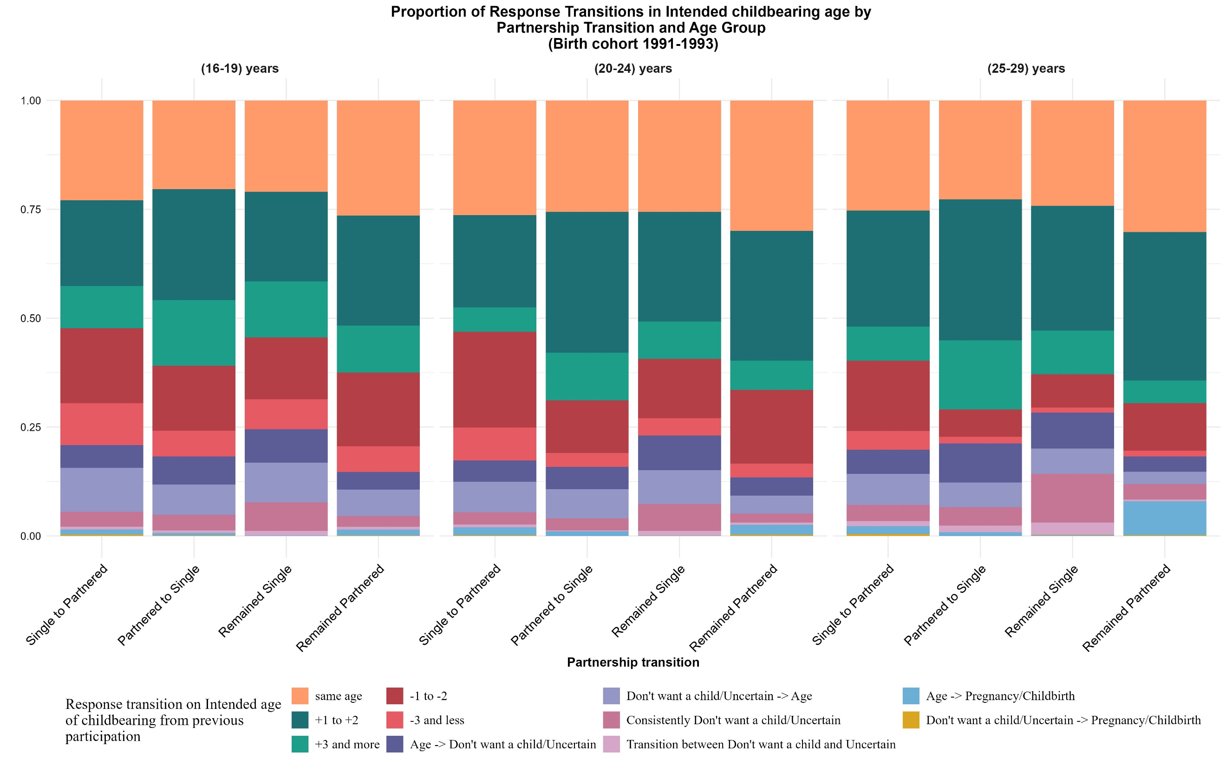

Slide 14
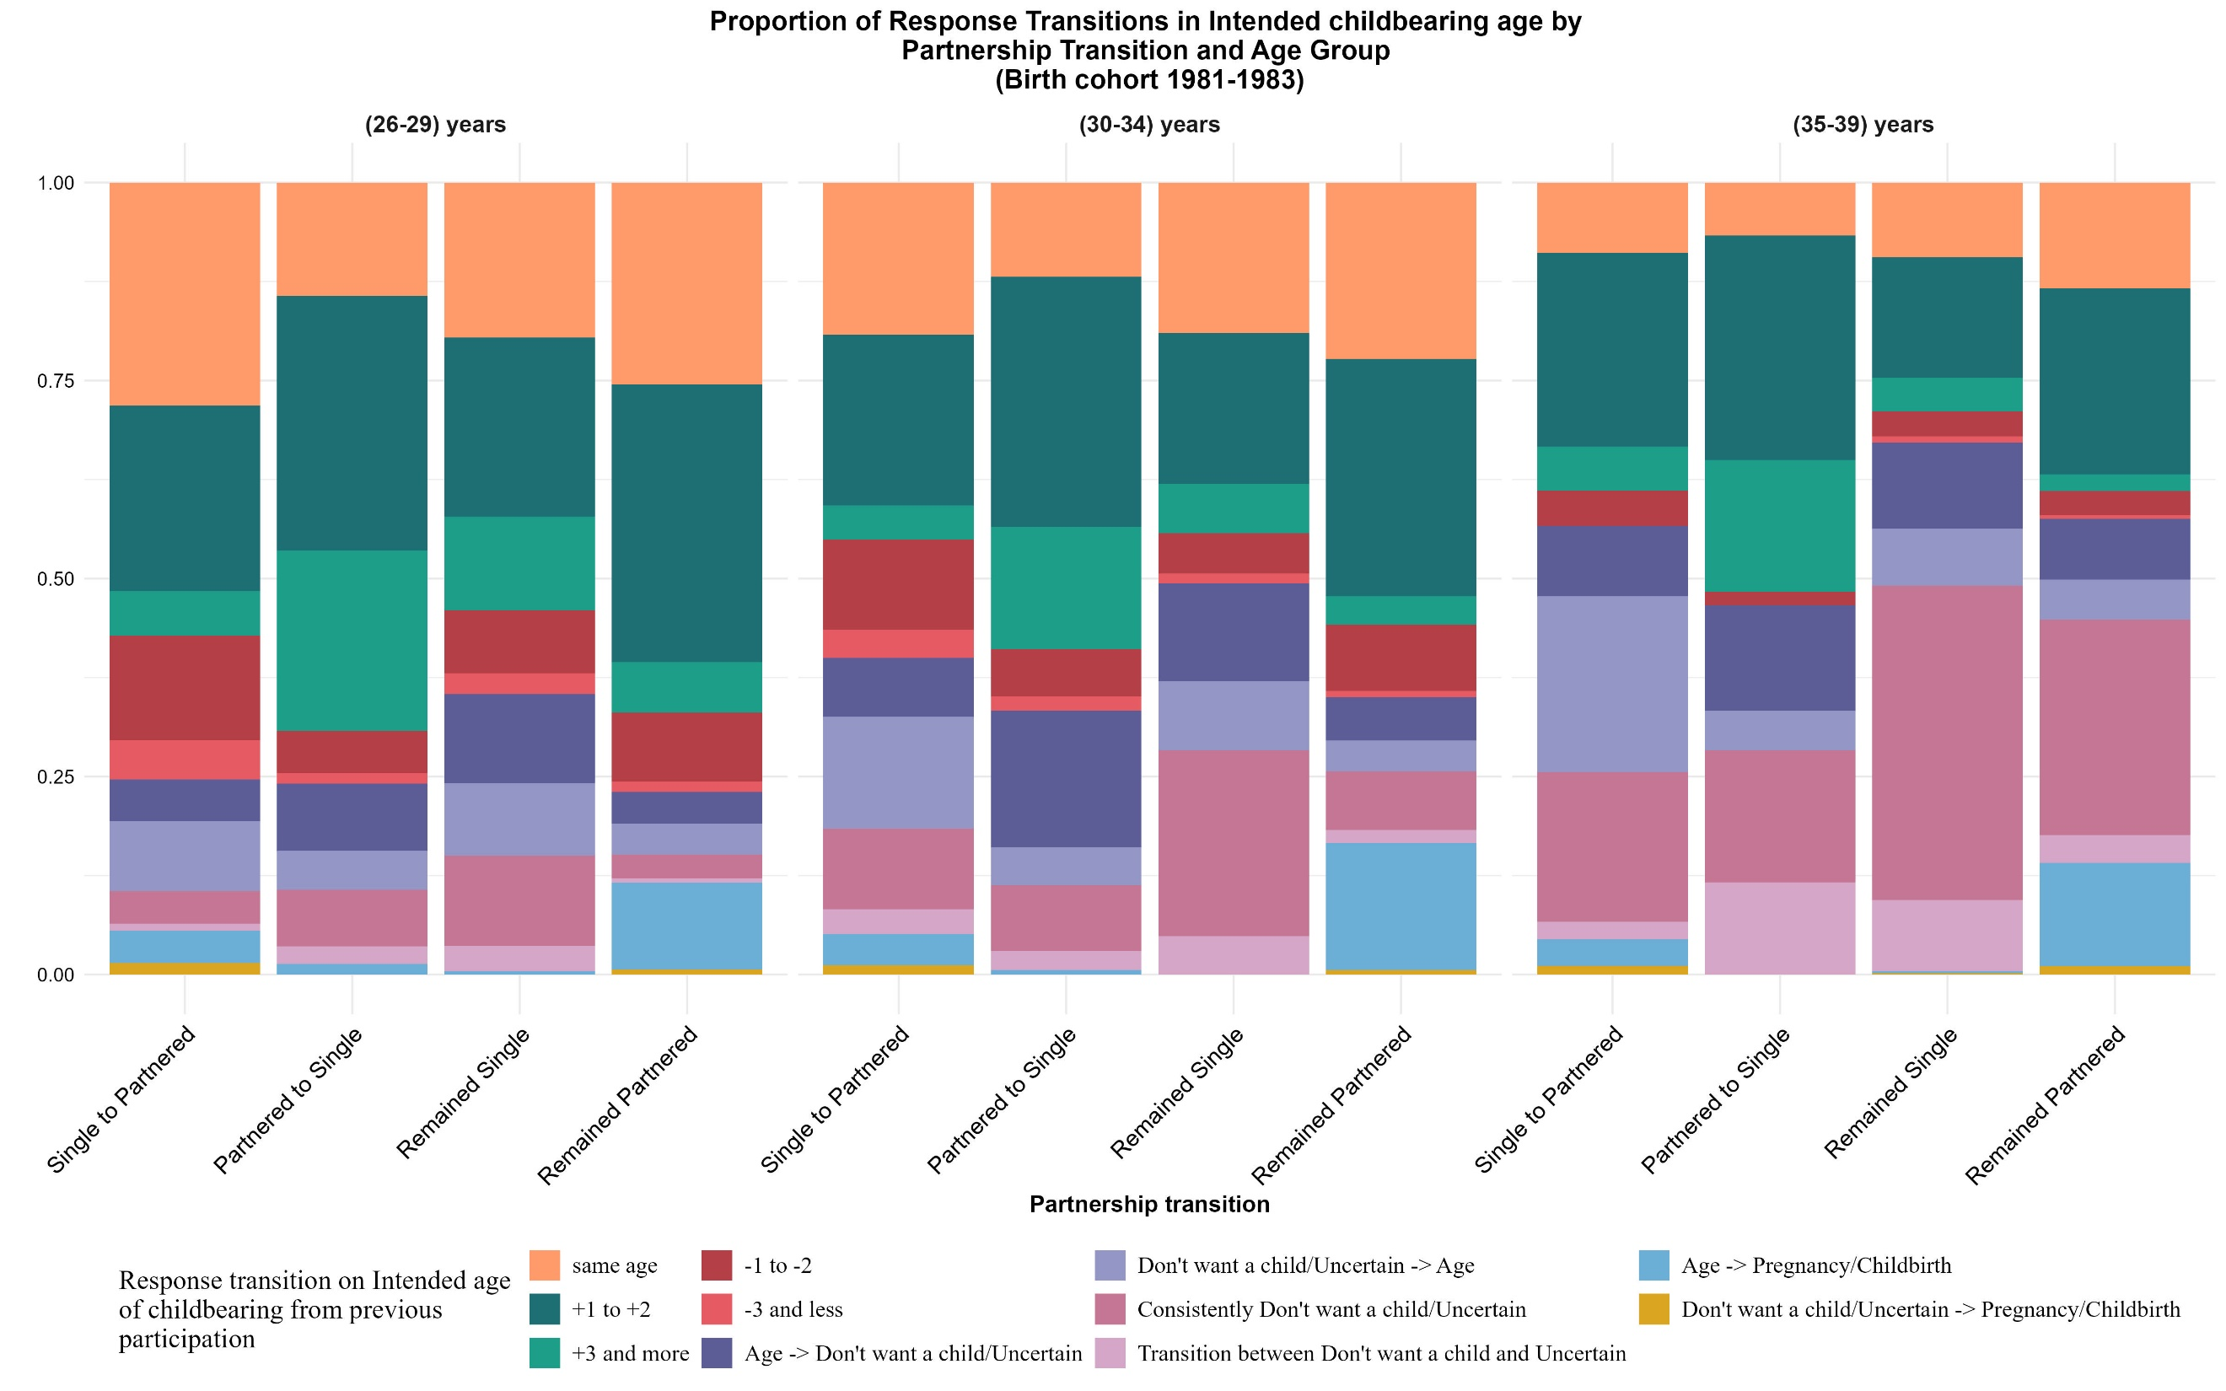

Slide 15
Conclusion
Age and partnership are important factors for childbearing timing decisions.
A clear digit preference (5,0, even numbers) in Intended realistic age to enter parenthood.
In late 30s, large proportion of childless people give up on their childbearing intention.
Higher proportion of men aim for higher age than women at each age.
At young age (for cohort 1991-1993), partnership transition does not have much effect on fertility timing intentions.
Partnership transition coupled with higher age significantly impacts fertility timing intentions.

