Slide 1

Later and Lower Marital Fertility in Japan: the Role of Infertility and Assisted Reproduction
Ester Lazzari¹, University of Vienna Setsuya Fukuda², National Institute of Population and Social Security Research Shohei Yoda², National Institute of Population and Social Security Research James M. Raymo³, Princeton University
International Symposium on Medically Assisted Reproduction
Villa Vigoni, 16-18 September 2024

Slide 2
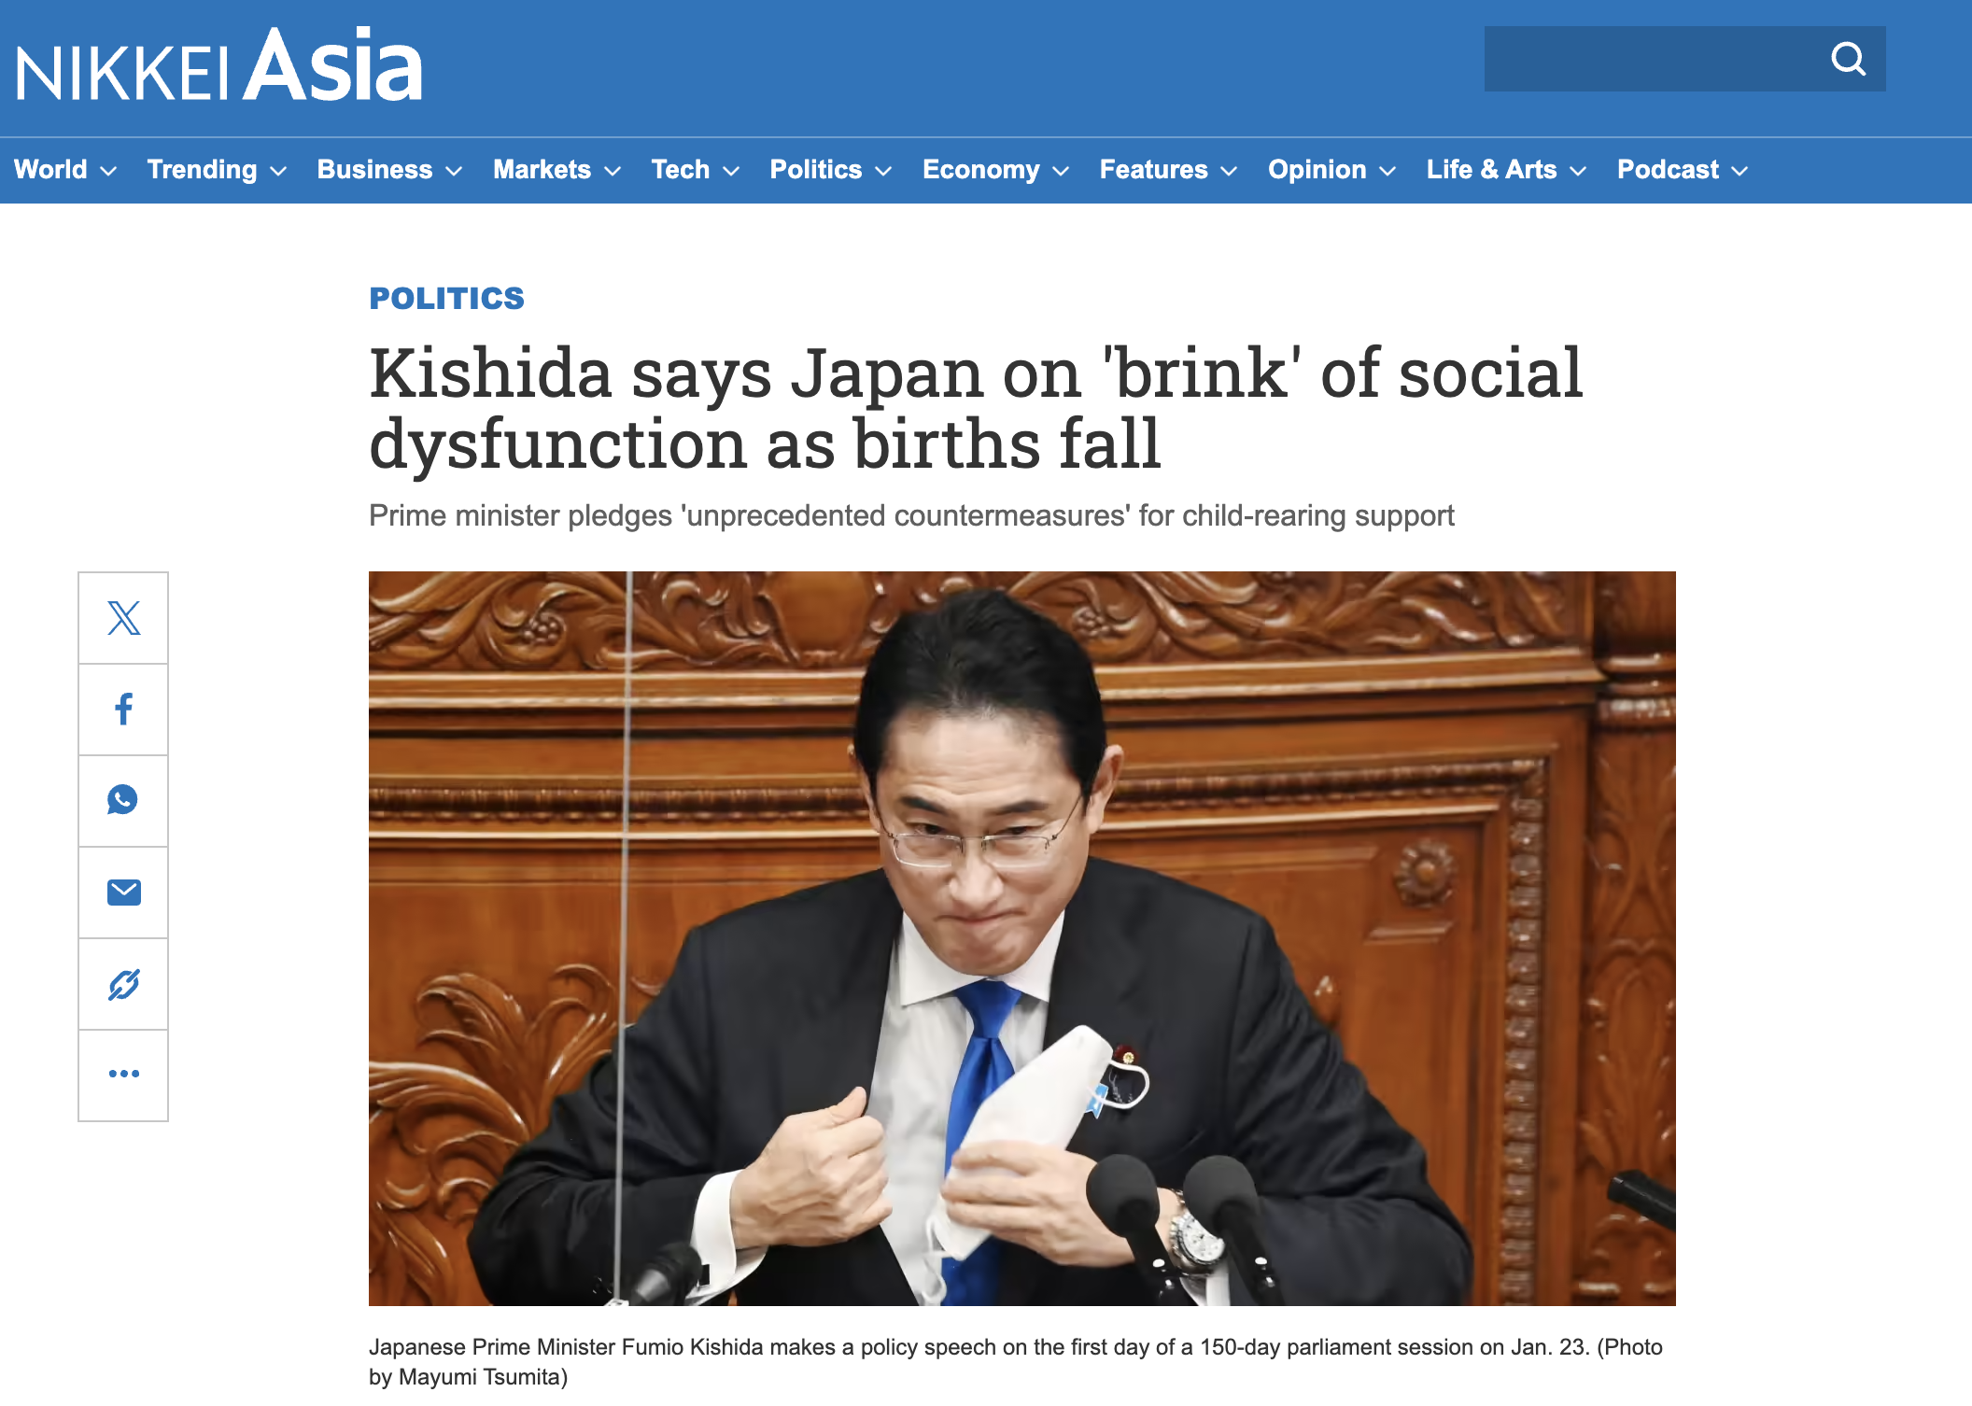
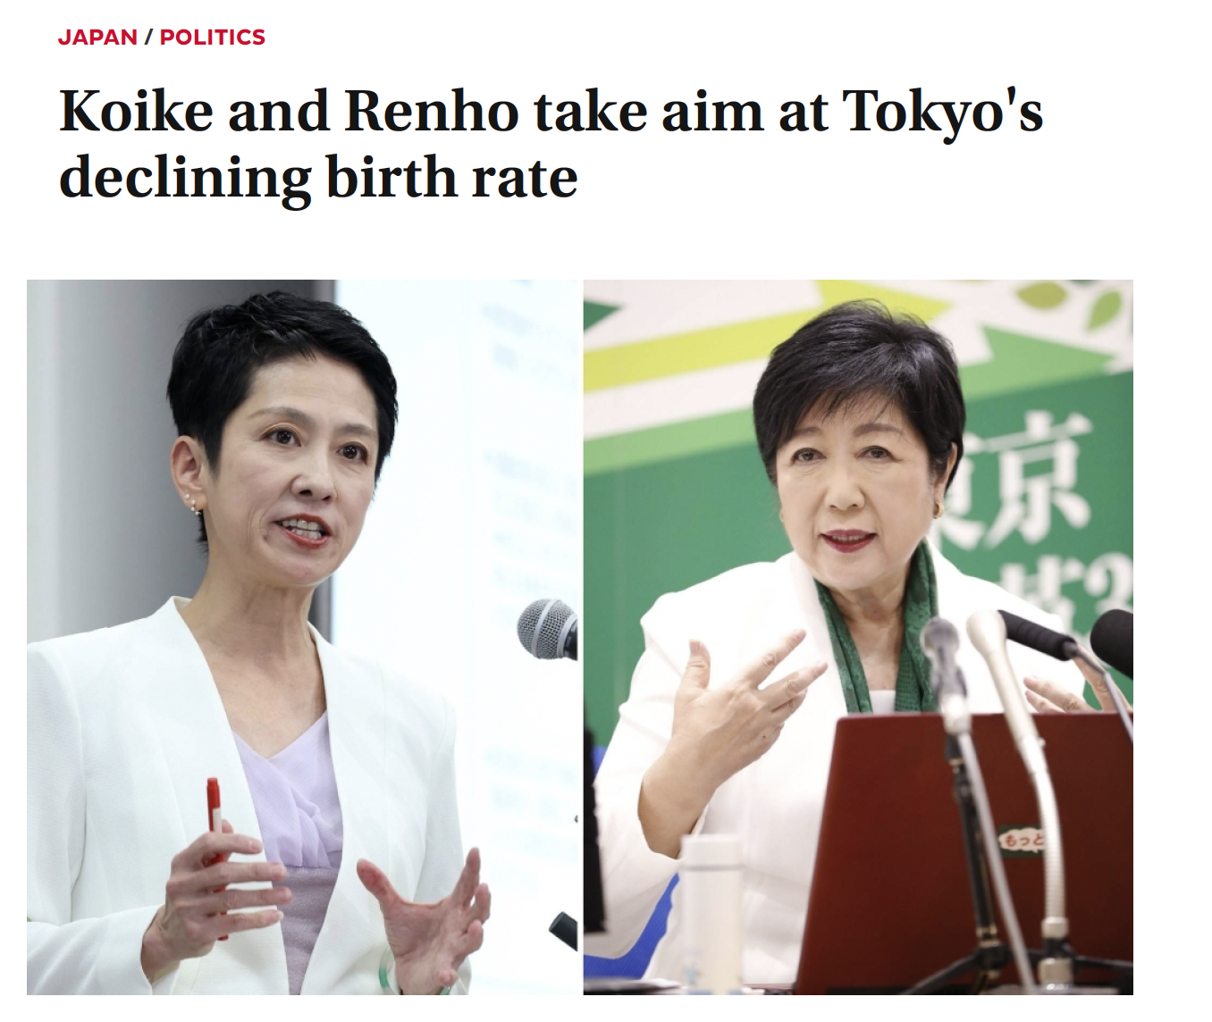

Slide 3
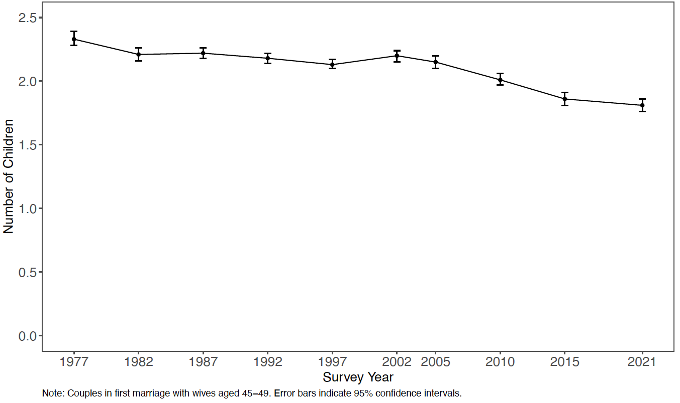
Demographers’ skepticism (1)

Slide 4
Another view (1)

Slide 5
Another view (2)

Slide 6
Another view (1), by educational attainment

Slide 7
Later marriage

Slide 8
Contribution of ART to the birth rate
Highest volume of ART activity worldwide (Chambers et al. 2021)
69,797 ART babies born in 2021 (Katagiri et al. 2023)
Source: Authors’ calculations based on data sourced from the JSOG registry (Katagiri et al. 2021) and the Human Fertility Database (HFD 2024).

Slide 9
Evolution of MAR policies
2 0 0 6
Duration of subsidy goes from 2 to 5 years
2 0 1 5
Men's treatment included for subsidy + subsidy raised for the first time treatment
2 0 0 9
2 0 1 1
2 0 1 4
The amount of subsidy increased from 0.1 to 0.15 million JPY per treatment
From once to twice per FY + income threshold raised from 6.5 to 7.3 million
From twice to 3 times in the first FY
Duration of subsidy goes from 5 years to unlimited and introduction of an age limit of 40 for women, 6 times
2 0 1 6
2 0 2 0
A p r i l 2 0 2 2
2 0 0 7
2 0 1 9
Extension to women aged 40-42, 3 times
Subsidy for men's treatment raised to 0.3 million JPY
Subsidy for both men and women raised to 0.3 million JPY each time + No income cap
Health coverage replaces government subsidy

Slide 10
Research objectives
Describe infertility prevalence (or anxiety) and MAR use in Japan
Calculate the contribution of MAR to marital fertility rates
Quantify the extent to which MAR use contributes to reducing the gap between ideal and achieved number of children

Slide 11
Data
Multiple rounds of the Japanese National Fertility Survey (collected in 2002, 2005, 2010, 2015, and 2021).
Sample: Married women aged 40+
Do you and your husband have any concerns or worries about infertility?
=> Infertility anxiety (or prevalence)
Have you ever been treated for infertility?
=> MAR use
Did you have a child as a result of infertility treatments?
=> MAR success rates

Slide 12
Research objectives
Describe infertility prevalence (or anxiety) and MAR use in Japan
Calculate the contribution of MAR to marital fertility rates
Quantify the extent to which MAR use contributes to reducing the gap between ideal and expected number of children

Slide 13
Ever worried about infertility

Slide 14
Ever used infertility treatment

Slide 15
Had a birth as a result of infertility treatment

Slide 16
Fertility worry, MAR use, MAR births

Slide 17
Research objectives
Describe infertility prevalence (or anxiety) and MAR use in Japan
Calculate the contribution of MAR to marital fertility rates
Quantify the extent to which MAR use contributes to reducing the gap between ideal and expected number of children

Slide 18
MAR contribution to completed marital fertility
(8% lower)

Slide 19
MAR contribution to completed marital fertility, by education
(6% lower)
(7% lower)
(12% lower)

Slide 20
Research objectives
Describe infertility prevalence (or anxiety) and MAR use in Japan
Calculate the contribution of MAR to marital fertility rates
Quantify the extent to which MAR use contributes to reducing the gap between ideal and intended number of children

Slide 21
What if there was no MAR?

Slide 22
Conclusion
Infertility is a major challenge for family building in Japan
Unequal impact on family-building opportunities because access to MAR is unequal at all levels of the treatment seeking process
MAR contributed to the gap between desired and achieved family size
Expanding access to MAR offers a unique solution for couples facing biological barriers to family building.

